Slide 1
Test Data Analyzer (TDA)

Slide 2
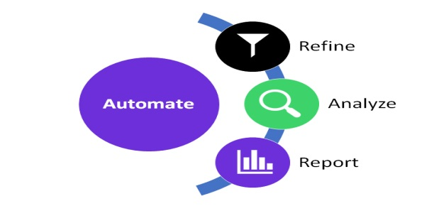
What & Why is Test Data Analyzer?
Business Challenge:
In Solution central majority of the POR/ US requests are dependent on Data conditioning, where team has to check for data being available in multiple areas like Ehub, IMSN and IMSW.
Solution:
This tool has provided solution where these checks can be automated using API calls and RPC calls, where the utility will take bulk Data at single shot which needs to be checked out as input from the user and provide an output file where filtering techniques can be applied to setup the data if needed for upload into the APT tool.

Slide 3
Process for Data Validation - Before TDA
Data Provided by Business
YES
NO & Check the next condition and return back once its true
Check if available in IMSN to get details and load in EHUB
Check in SC if Available in EHUB
Check if Available in IMSW
Get details from IMSN & copy in IMSW
Check if available in IMSW to copy to IMSN
Completed
Get back to Business

Slide 4
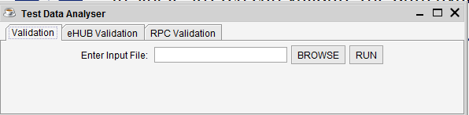
Test Data Analyzer - Process & Benefits
Received data
Received data from the business for respective POR
Validate in TDA
In single stretch can validate the data availability in IMSN,IMSW & EHUB
Steps to use the tool:
Upload the excel with Bulk data
Run the tool with any option available mentioned below
1. Validation - Ehub ,IMSN & IMSW in single shot
2.Ehub validation alone
3. RPC Validation –IMSN &IMSW
Get the results

Slide 5
Test Data Analyzer - Benefits
Benefits of Test Data Analyzer:
Validate data in all source IMSN,IMSW & EHUB on single shot
Reduces the Human effort ~ 5 Mins
Validate Bulk test data on single shot
Reduces the effort of fetching data for DATA copy & EHUB Load in APT Tool
Can utilize for API & RPC validation as well individually
Sample Validation done in December for verification of tool:
Attached the sample details

